Slide 1
DDCA PROJECT
DESIGN & SIMULATION OF AN
8-BIT SIGNED
ARITHMETIC UNIT
8-BIT
ALU
A compact digital unit for signed arithmetic operations
GROUP 14 | TEAM MEMBERS
1. Name: Aryan Roll No: 2620080033
2. Name: Jeshwin Roll No: 2620080043
3. Name: Saharsha Roll No: 2620080091
4. Name: Nivrithi Roll No: 2620080109
5. Name: Eesha Roll No: 2620080116

Slide 2
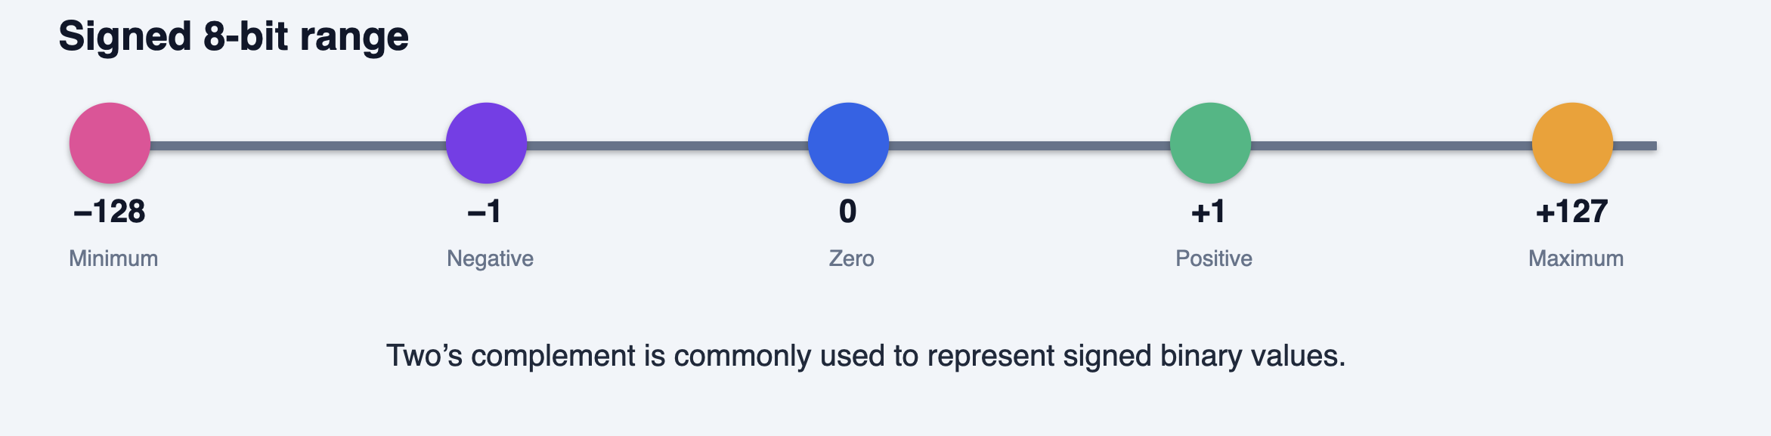
INTRODUCTION
What the ALU does
From specification to a working combinational circuit.
ARITHMETIC LOGIC UNIT
PROJECT OBJECTIVES
The CPU’s
calculation core
01
Design
8-bit signed ALU
02
Support
ADD · SUB · AND · OR · SLT
An ALU performs arithmetic and bitwise logic operations. This design uses 8-bit signed two’s-complement inputs and a 3-bit operation selector.
03
Verify
results and status flags
+127
COMBINATIONAL · NO CLOCK
SUCCESS CRITERIA
Correct OP selection
Signed two’s-complement behavior
Simulation matches expected output

Slide 3
Theory & Logic Circuit
Signed arithmetic and circuit concept
Two’s complement
Arithmetic blocks
Control / MUX
8-bit signed range: −128 to +127. Negative values are represented using invert-and-add-one.
Adder, subtractor, multiplier and divider each calculate one operation.
Opcode selects the required result and sends it to the output.
Block diagram
ADD
A[7:0]
Operand A
SUB
MUX
Result [7:0]
B[7:0]
Operand B
MUL
DIV
Opcode / control bits select the operation.

Slide 4
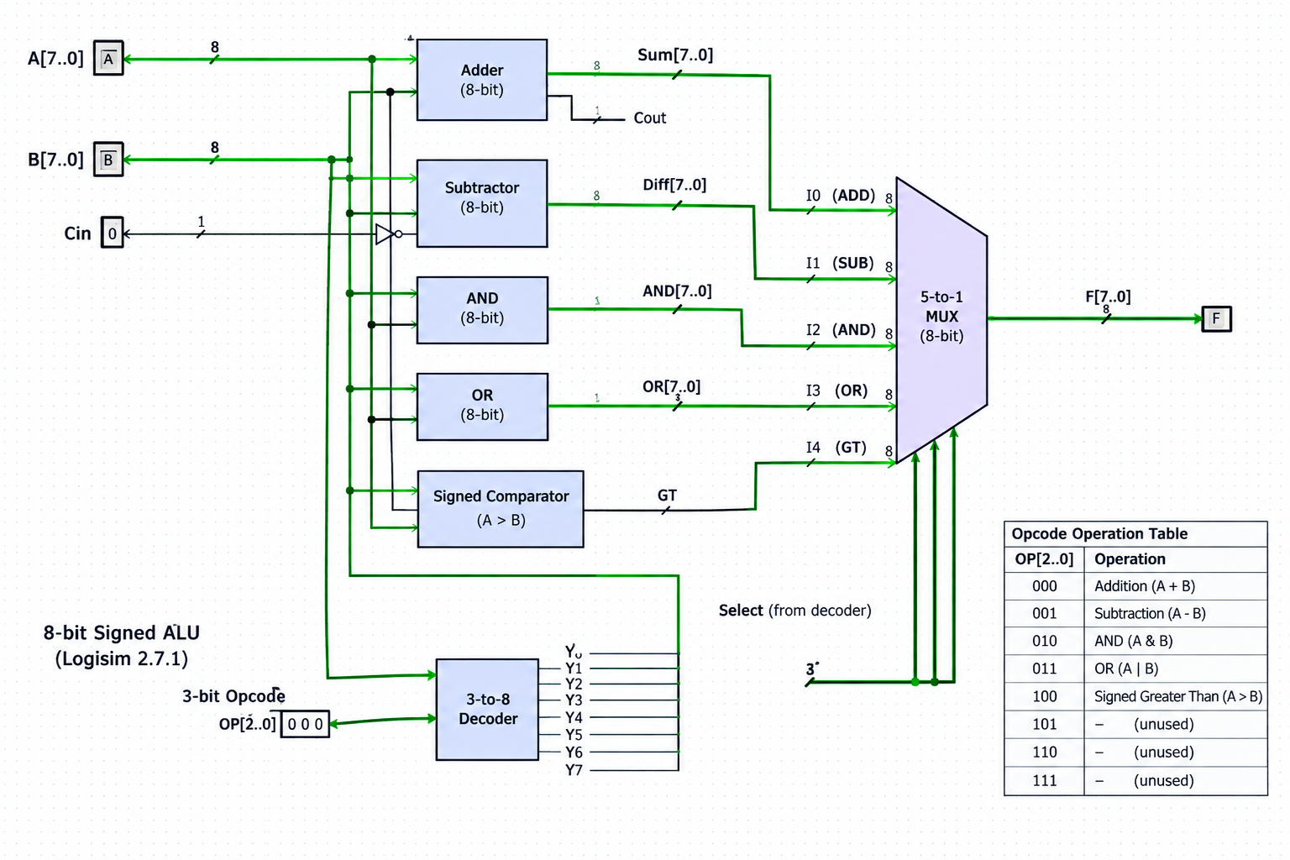
IMPLEMENTATION
Circuit design in Logisim
SIGNAL FLOW
Inputs
Place two 8-bit input pins for operands A and B.
1
Connect arithmetic components or subcircuits for each operation.
2
Compute
Select
Connect a multiplexer controlled by opcode bits to the output.
Show A, B, OP, operation blocks, selector and output pins.
3

Slide 5
VERIFICATION
Simulation results
Representative cases verify operation selection, signed behavior and overflow.
000
ADD
001
SUB
010
AND
011
OR
100
SLT
A
B
OP
FUNCTION
EXPECTED
SIMULATION CHECK
5
3
000
ADD
8
5
3
001
SUB
2
INPUT
A = 127 B = 1
−5
3
000
ADD
−2
OP = 000 · ADD
5
3
010
AND
1
5
3
011
OR
7
OUTPUT
3
5
100
SLT
1
−128
5
3
100
SLT
0
Compare actual Logisim output with each expected vector.
127
1
000
ADD
−128 · overflow

Slide 6
Conclusion & Applications
Outcome, uses and future improvements
Conclusion
Applications
The design combines four arithmetic operations and uses control bits to select an output. Simulation helps verify expected behavior.
• CPUs and microprocessors
• Embedded systems
• Calculators and digital controllers
• Digital signal processing
Future improvements
• Add overflow and error flags
• Support 16-bit / 32-bit inputs
• Handle divide-by-zero explicitly
• Implement and test on FPGA

Slide 7
Team 14
THANK YOU

